Slide 1

Economics –Project 2
Market Analysis – Operating Systems

Slide 2
Group Members
1) Aneri Sheth - 1401072
2)Hemil Gurjar - 1401002
3)Himanshu Budhia - 1401039
4)Janki Desai - 1401103
5)Kunal Suba - 1401097
6)Palash Hariyani - 1401101
7)Rajvi Prajapati - 1401033
8)Rupande Shastri - 1401102

Slide 3
Agenda
Introduction
Market Share Data – Quantitative Comparison
Qualitative Comparison
Market Analysis
Conclusion

Slide 4
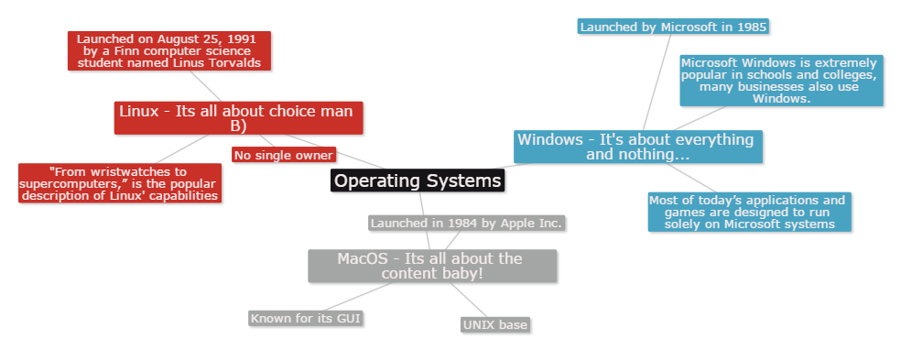
Introduction
Case Study – Operating Systems for PCs
Three main Operating System types

Slide 5
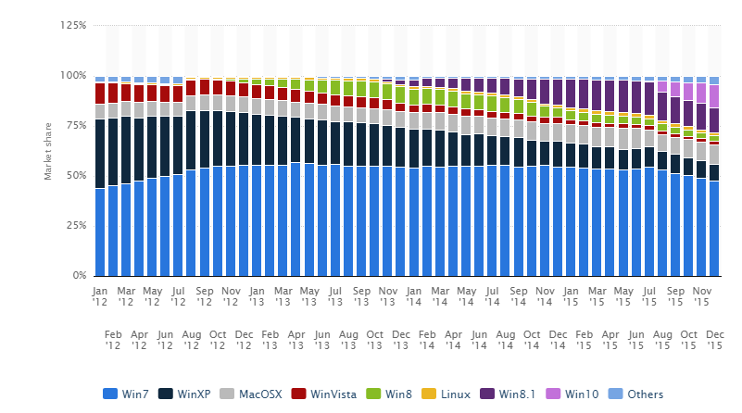
Market share data
Global market share held by operating systems
from January 2012 to December 2015

Slide 6
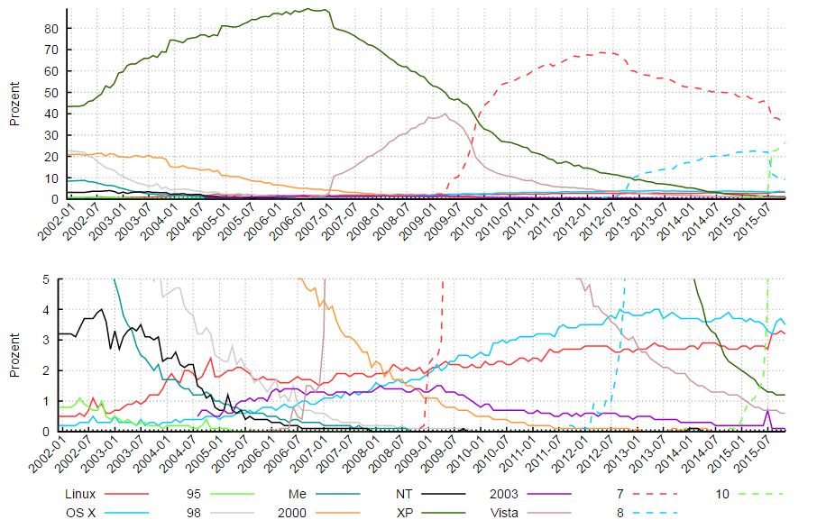
Development of desktop OS market shares at German website Computer Base since 2002

Slide 7
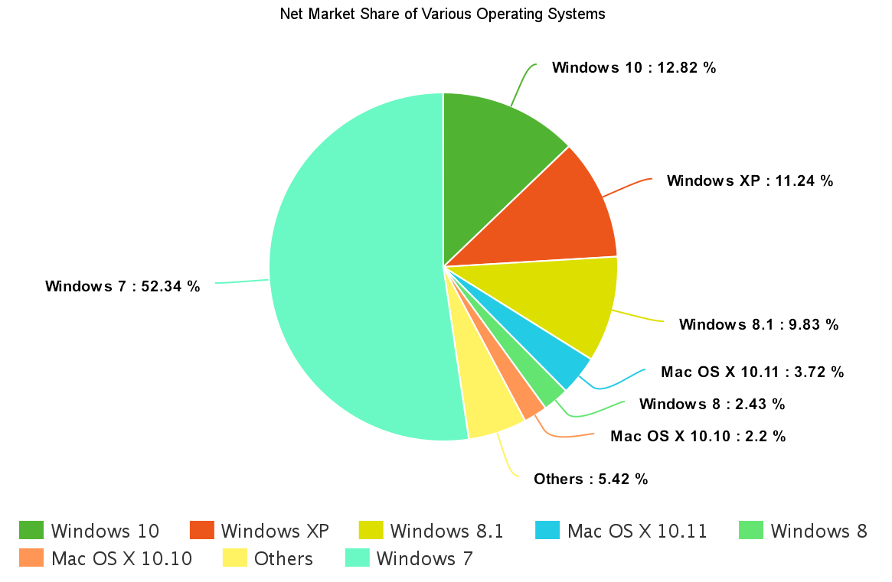

Slide 8
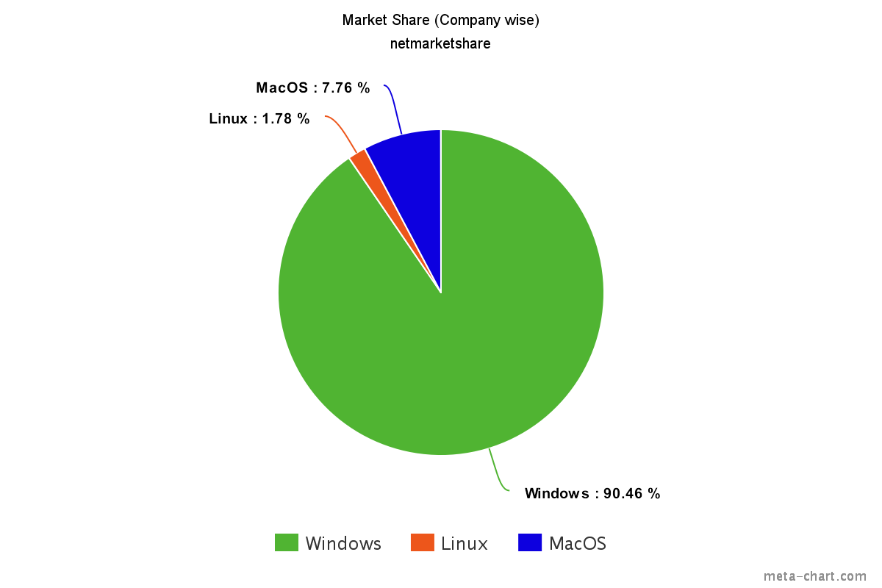
The data procured does not include copies of OS that are illegally
installed. (For Windows, 25-30% of all installations were illegal as
of 2015)

Slide 9
Qualitative Comparison
From studying the OS types qualitatively it is seen that Windows loses to Mac OS and Linux in technical aspects
However, the popularity of Windows leads to certain benefits

Slide 10
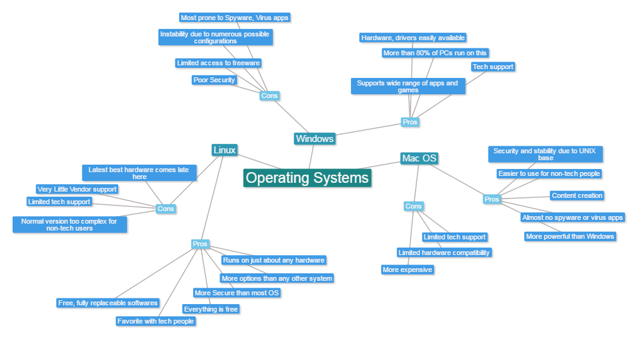

Slide 11
Market Analysis
Different categories of computers use a wide variety of operating systems, so the total usage share varies significantly from one category to another (product differentiation)
The graphs show that Windows OS has a clear win in the market share (more than 90%)
Technically, Linux and Mac OS turn out as good options as well

Slide 12
Oligopoly Market
It is a market where only a few firms make up the entire industry.
Mostly the products of these firms are alike which results into interdependence and gives them control over factors like price
For example, Coca-Cola and Pepsi.
Monopoly Market
It is a market where a single firm make up the entire industry
Here, the seller faces no competition, as he is the sole seller of goods with no close substitute.
For example, Torrent power station in Ahmedabad.

Slide 13
Oligopolistic market?
Characteristics | Our market
Few Firms | Yes
Interdependence | Yes
Non-price competition | Yes
Barriers to entry of new firms | Yes
Role of Selling Costs | Immaterial
Group Behavior | No
Nature of the Product | Imperfect Oligopoly
Indeterminate Demand curve | Yes

Slide 14
Monopoly market?
Characteristics | Our market
Single Seller | No
No close substitutes | Yes
No entry for new firms | No
Profit in the long run | Maybe
Losses in the short period | No
Nature of Demand Curve | Doesn’t match
Price Discrimination | No
Price Maker | No

Slide 15
Which Market?
The OS market is oligopolistic. However it is not a perfect oligopoly because:
Product differentiation: Although the firms sell the same product (OS), each OS has a specific use and set of characteristics
Unequal vendor support
Huge cost difference
In this imperfect oligopoly, Windows has a major lead over the other two.

Slide 16
Conclusion
On first sight, the graphs give signs of a monopoly market
On comparison it is shown that the OS market is an imperfect oligopoly with these three major firms selling the product
Windows rules the current OS Market

Slide 17
References
https://www.netmarketshare.com/operating-system-market-share.aspx?qprid=10&qpcustomd=0
http://www.w3schools.com/browsers/browsers_os.asp
http://www.statista.com/statistics/218089/global-market-share-of-windows-7/

